Slide 1
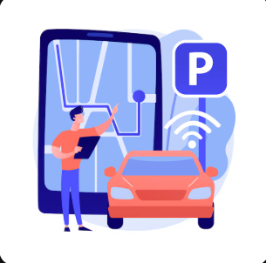

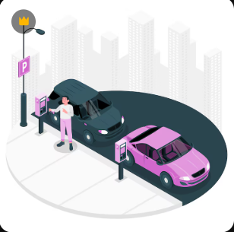
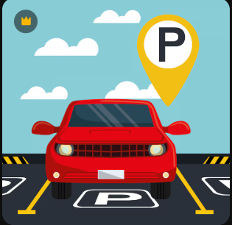
ParkPal – Smart Parking, simplified
UX Case Study
Researchers and Designers:
Soorya Prakash R (2023503502)
Kirubakaran V (2023503546)
Perumall rishi P (2023503551)
Sowmiya Narayanan(2023503582)
Dharanidharan L (2023503508)
Sibichakaravarthi S (2023503027)

Slide 2
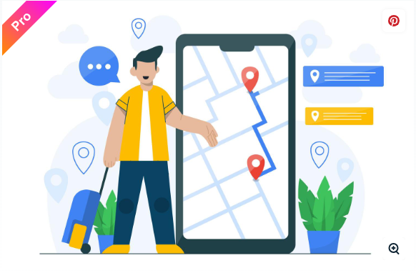
What is ParkPal?
ParkPal is a smart parking solution for urban drivers frustrated by wasted time, fuel, and stress while searching for an open parking spot. It connects drivers with real-time available parking, leveraging accurate data and a simple, reliable interface. ParkPal aims to reduce traffic congestion, and carbon emissions, and provide a seamless parking experience.

Slide 3


Problem Statement
Difficulty finding real-time available parking in busy cities.
Wasted time, fuel, and productivity due to inaccurate or outdated information from existing apps.
Frustrating user experiences because of complex app interfaces.
Contributing to city traffic and environmental pollution.
Proposed Solutions
Real-time, accurate parking availability maps.
Integration with smart sensors and crowd-sourced updates.
Simple, minimal interface for quick use while driving.
Route guidance directly to the nearest vacant spot.
Options for advance bookings and digital payments.
Community features for reporting and verifying spot accuracy.

Slide 4




Design Process
Understand
Define
Ideate
Design
User interviews with city drivers, parking lot owners, municipal authorities.
Competitor analysis of leading parking apps.
Field observations of parking search challenges.
Define what makes parking search frustrating.
Map out varied user journeys (daily commuters, shoppers, visitors).
Brainstorm features: live feed, booking, spot verification, incentives for reporters.
Sketch wireframes with minimal UI for use on the go.
Create high-contrast, clean prototypes for fast readability.
Usability tests with drivers in real-world scenarios.
Iterate based on feedback and analytics.

Slide 5

Target Audience
Urban drivers (commuters, shoppers, families)
Tourists visiting city centers
Parking lot owners and managers
Delivery and service vehicle drivers

Slide 6

User Interview
No. people interviewed: 4-6
Questions Asked
What difficulties do you face finding parking?
How do current parking apps help or fail you?
What features would make such an app indispensable?
How often do you park in high-traffic areas?
Which existing apps do you prefer, and why?
Would you contribute parking info if it helps others?
What concerns do you have about privacy/location sharing?

Slide 7


Answers
Rohit,
Office Commuter
Nisha,
Delivery Driver
A) Major difficulty is outdated info—apps show spaces that aren't available.
B) Current apps are slow and s sometimes require too many steps.
C) Must have live updates and a booking option—make it fast!
D) Use Google Maps, but it's not tailored for parking.
E) Yes, would report info if it benefited me too!
A) Finding parking quickly is crucial for my job. Circling blocks wastes time. B) Apps often cover only big lots, not small roadside spots. C) Simple map view, voice alerts for free spots. D) Rarely use any, too complex. E) Yes, especially for incentives.

Slide 8

Meera, Tourist
A) Don't know local parking rules, lots are confusing.
B) Apps are often in local language, hard to navigate.
C) Clear instructions, transparent pricing, tourist mode.
D) Try various apps, none fully satisfy.
E) Would help if info is shared safely.

Slide 9
Features Roadmap
A feature roadmap is important for the ParkPal project because it gives a clear direction for how the app will grow step by step. It helps us understand what features to build first and what to add later, making the whole development process easier and more organized. With a roadmap, the team can work smoothly, avoid confusion, and stay focused on the same goals. It also makes it simple to explain the project plan to others and show how ParkPal will improve from a basic parking app into a complete smart parking solution.

Slide 10
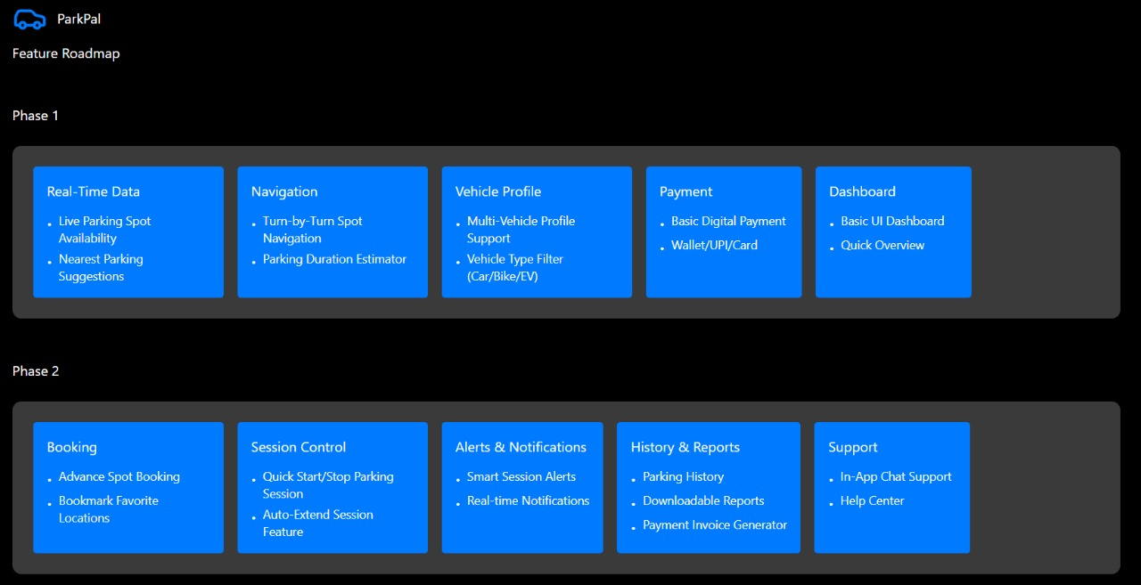
Phase 1 & Phase 2

Slide 11
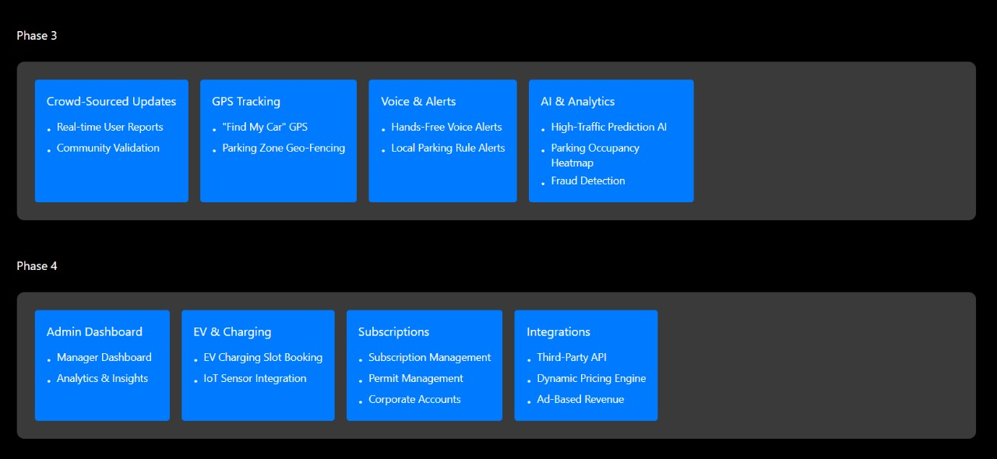
Phase 3 & Phase 4

Slide 12
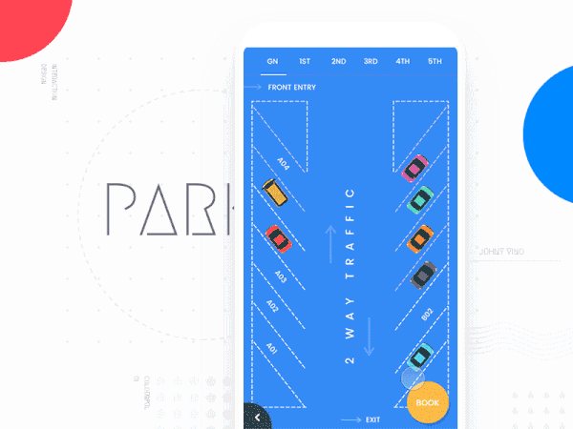
Platforms and Resolutions
For ParkPal, I chose a cross-platform design so the app can run smoothly on all major devices. Since parking information must be accessible anywhere, supporting multiple screen sizes is essential. I also included four modes—Dark Mode, Light Mode, Dark Accessibility Mode, and Light Accessibility Mode—to ensure that users with visual difficulties, including color blindness, can use the app comfortably.
The resolutions I designed for are (pixels):
Mobile : 0 ~ 559 Phablet : 560 ~ 769 Tablet : 770 ~ 991 Desktop Small : 992 ~ 1439 Desktop Large : 1440 ~ 2559 4K Display : 2560 and above

Slide 13
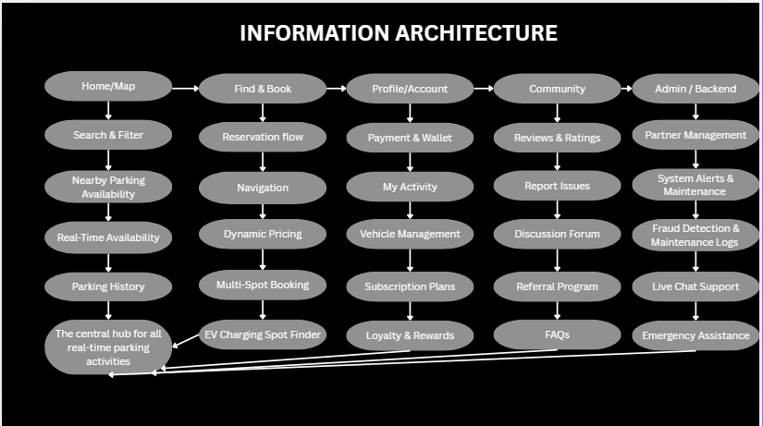

Slide 14
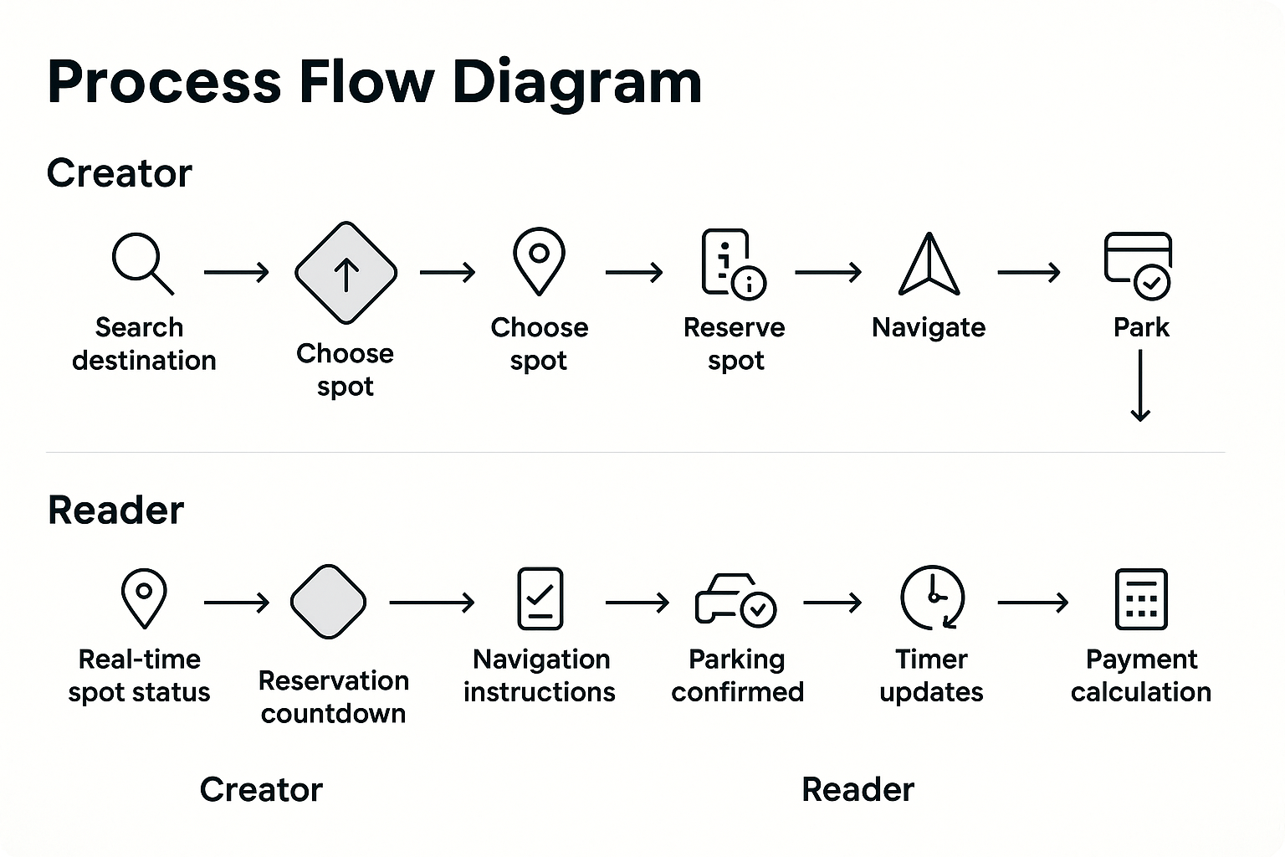

Slide 15
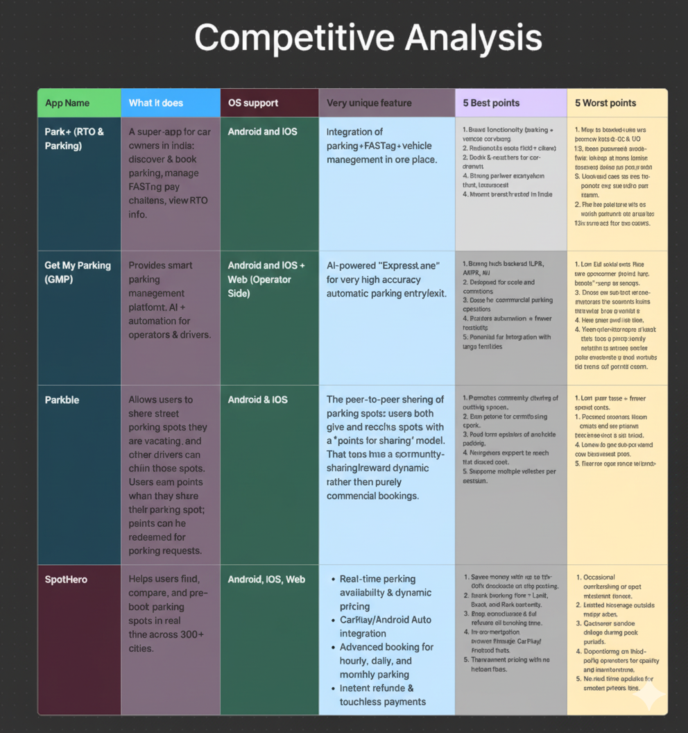

Slide 16
ParkPal – Parking surveys and Insight

Slide 17
Pain Points
1. Spot verification challenges
2. Real-time accuracy issues
3. Referral fraud risks
4.Partnership & legal constraints
5.Guaranteed spot allocation difficulty
6. High infrastructure costs
7. Liability & safety concerns

Slide 18
Survey Summary
46% struggle to find parking a few times a week
48% spend 10–20 minutes searching
63% would use a parking app
49% may subscribe
57% would refer spots for money
Preferred price range: ₹149–₹199

Slide 19
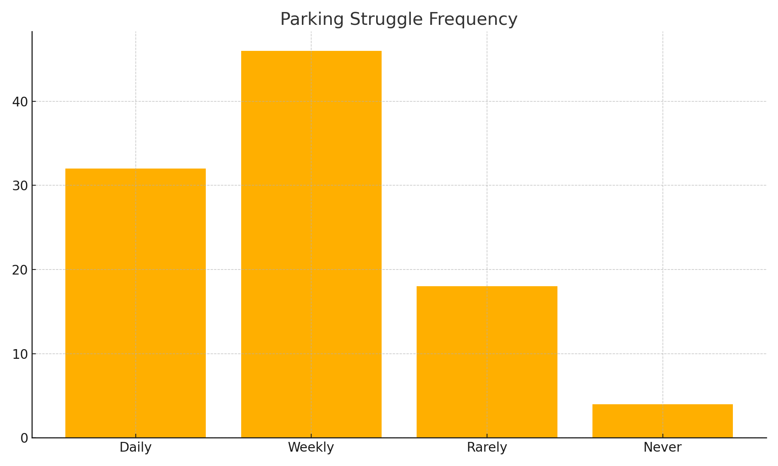
Parking struggle graph
01
02
03

Slide 20
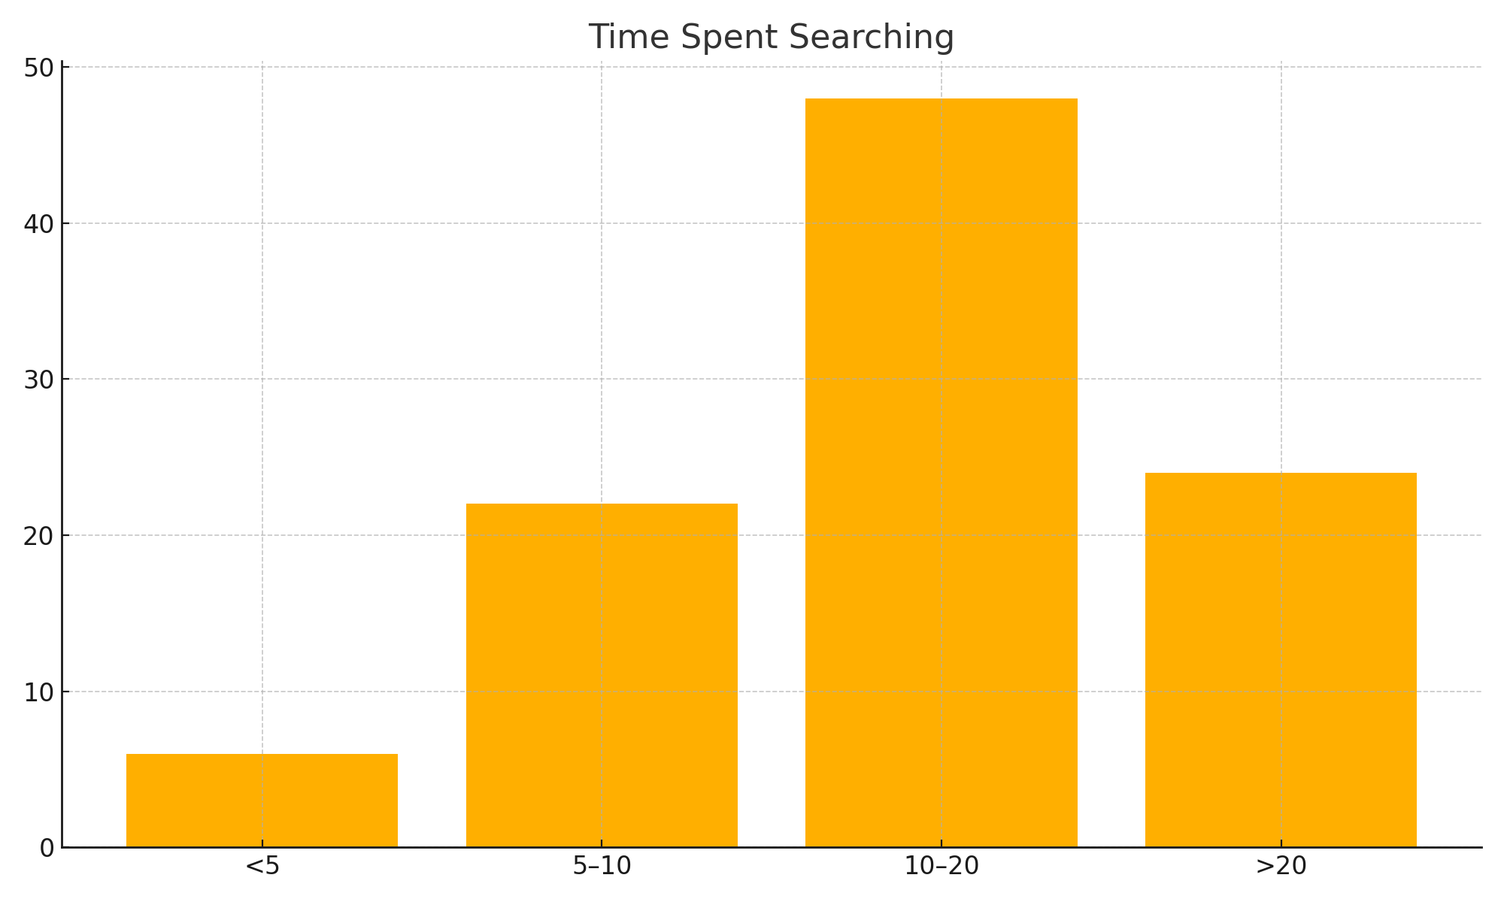
Time spent to search for parking

Slide 21

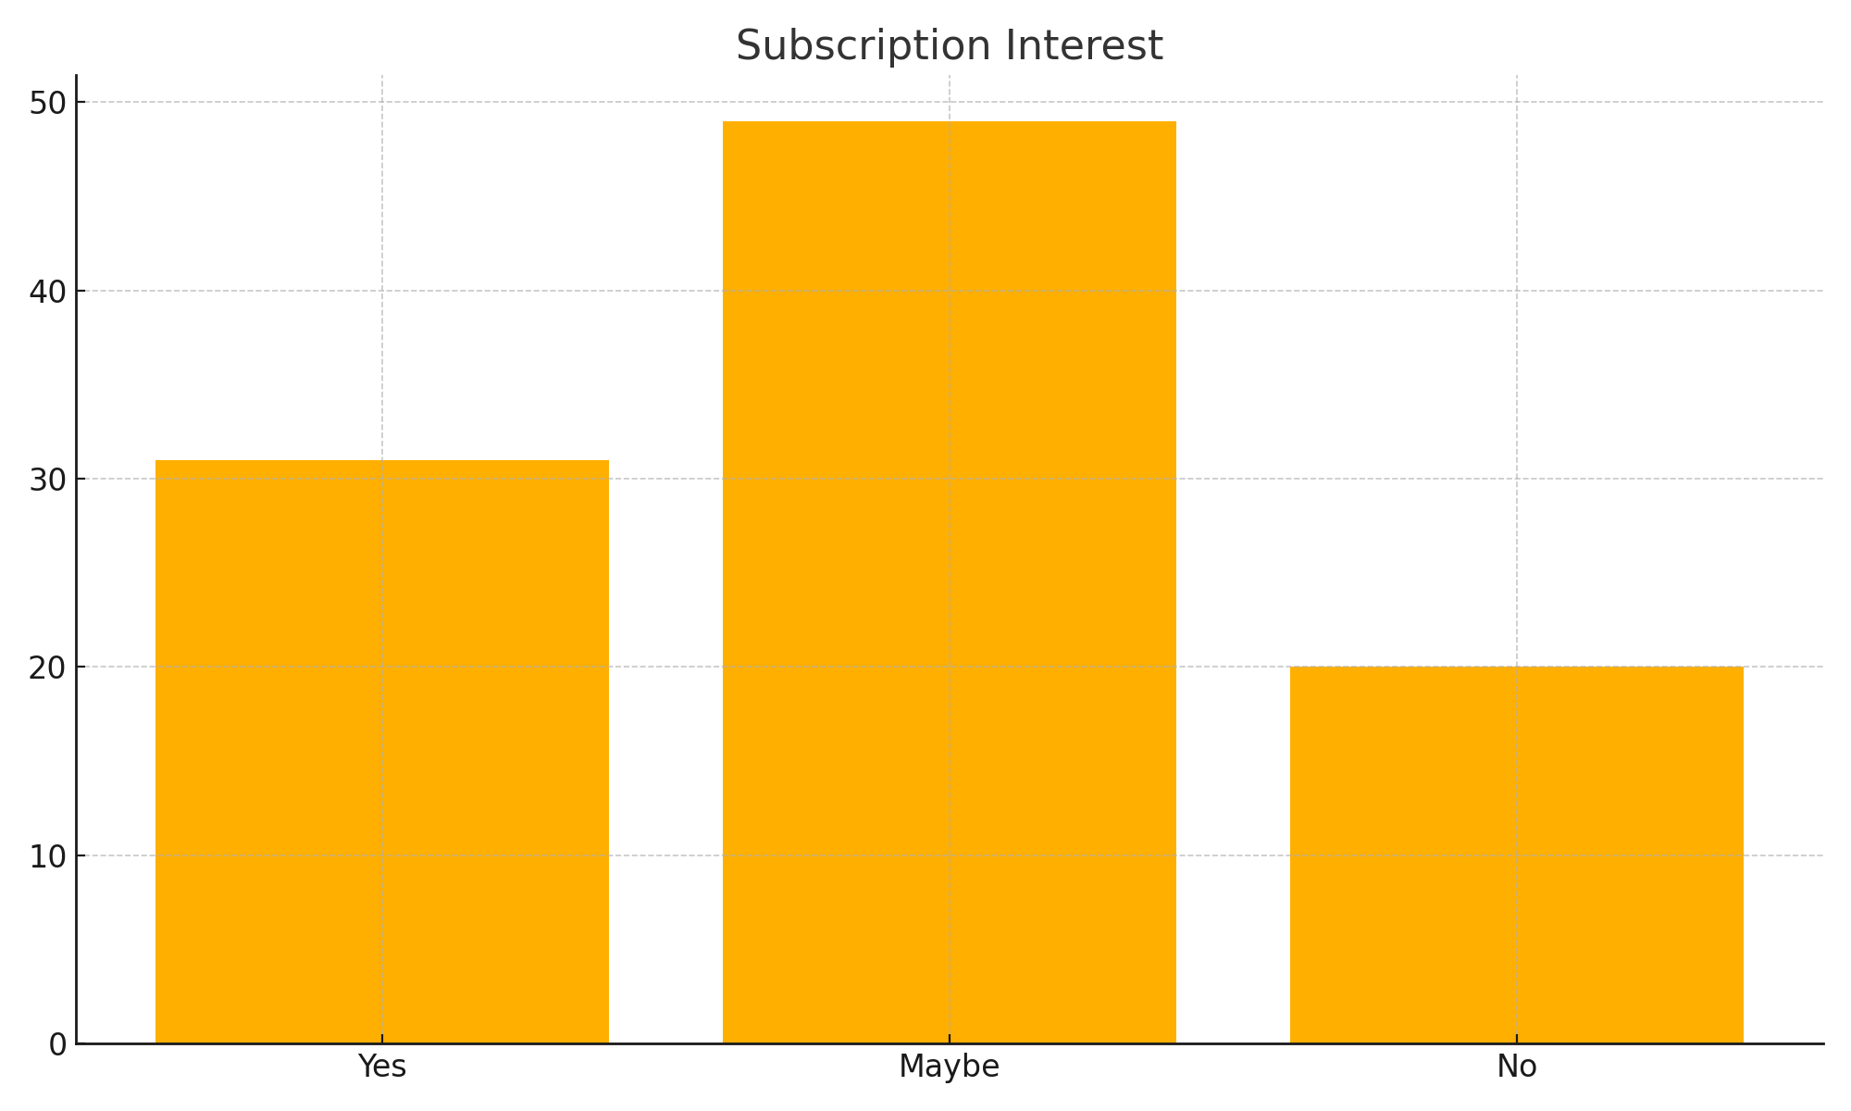


Subscription interest

Slide 22
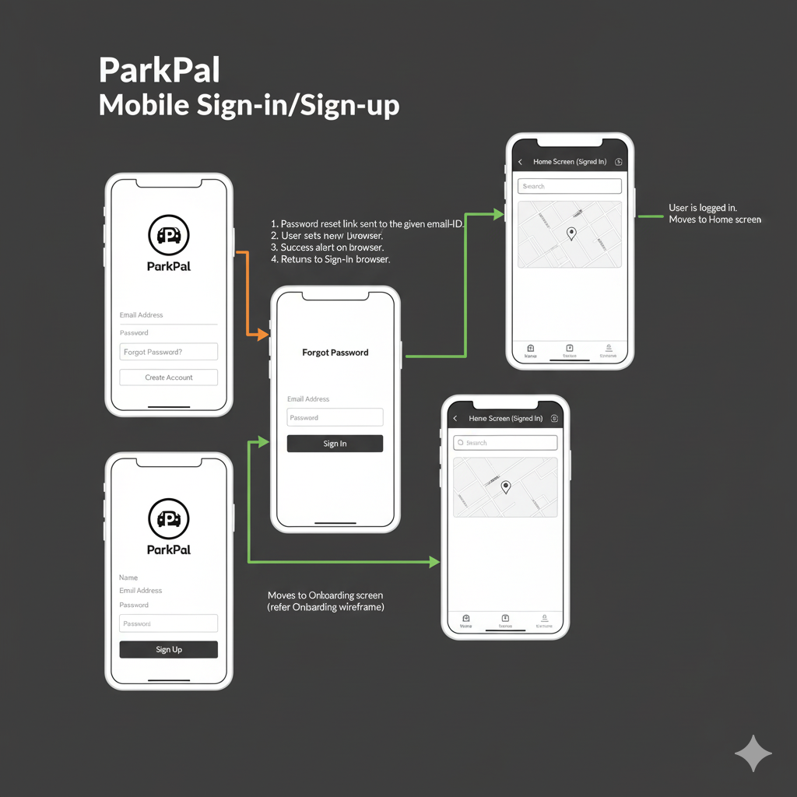
Wireframes Mobile

Slide 23
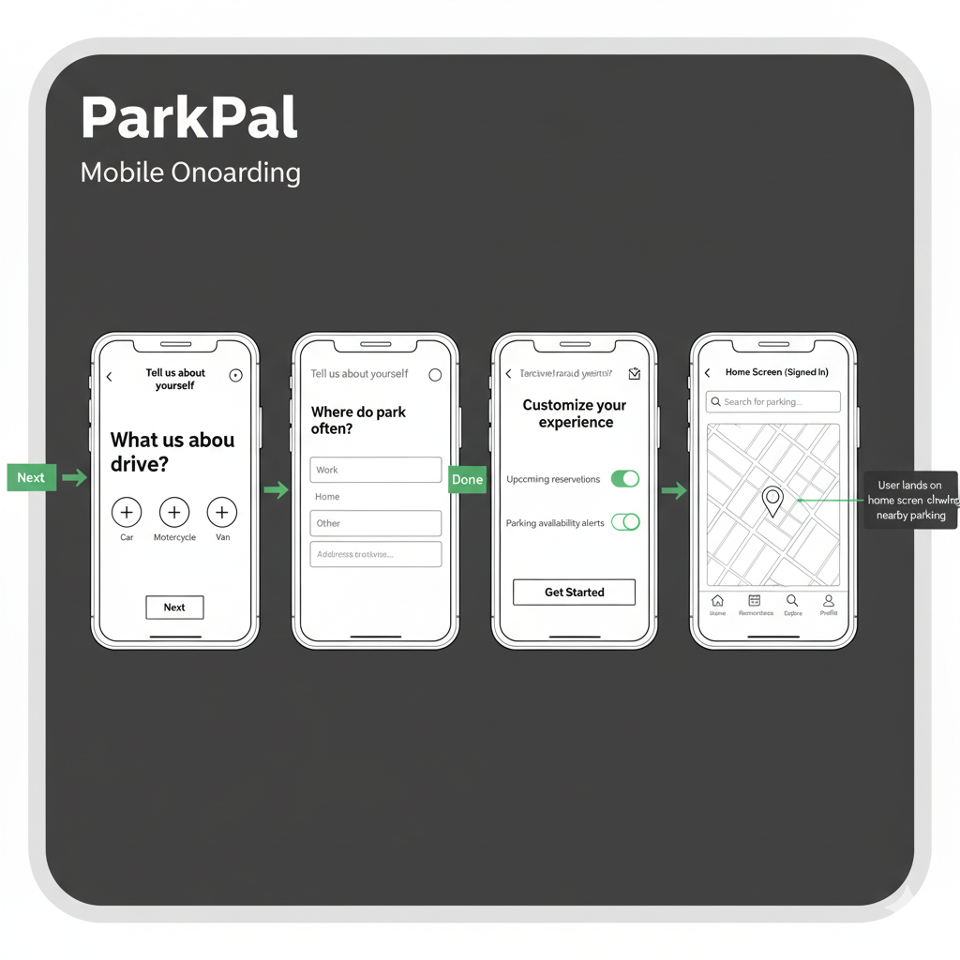

Slide 24
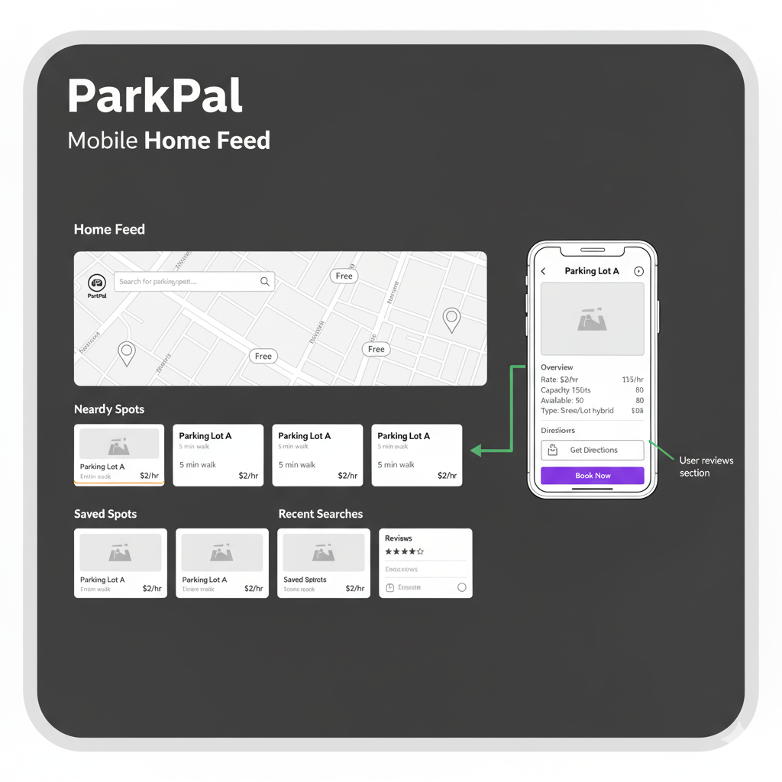

Slide 25
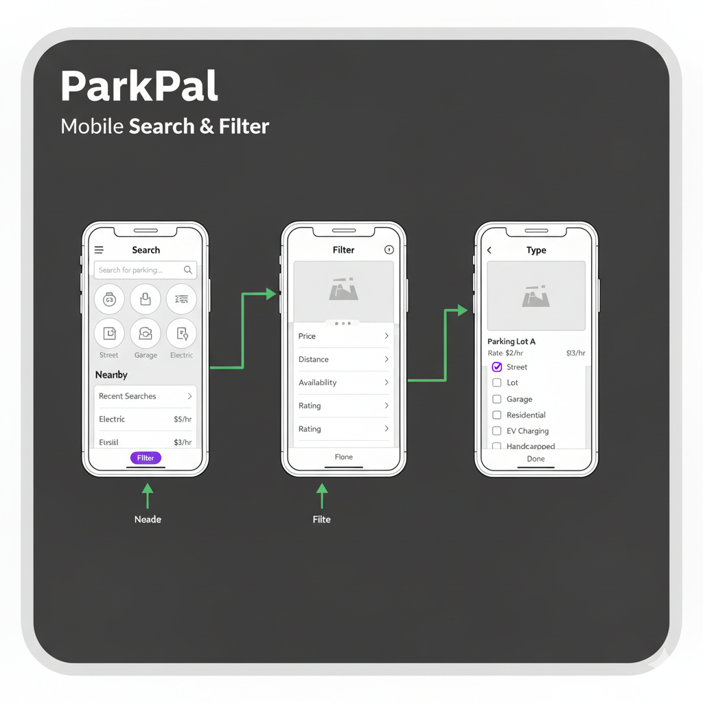

Slide 26
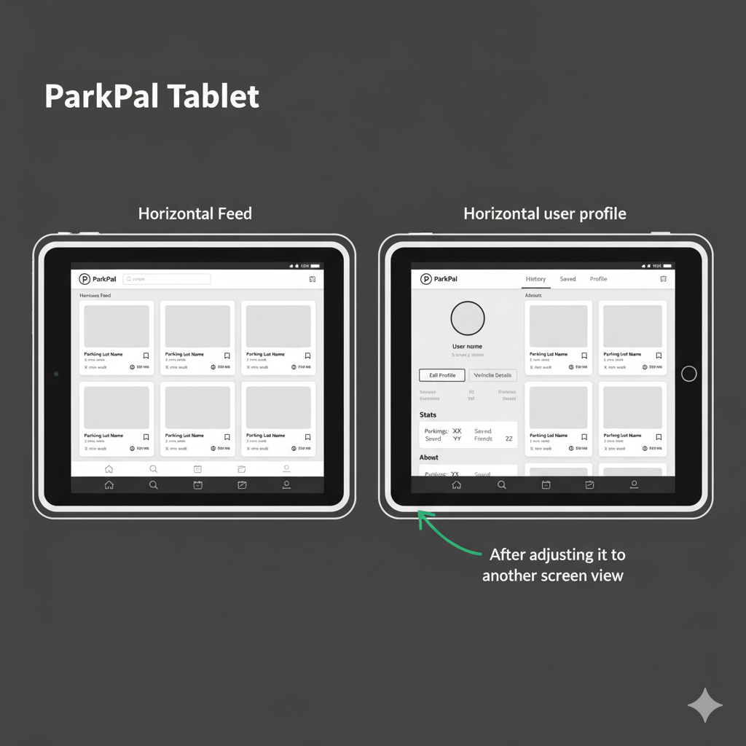

Slide 27
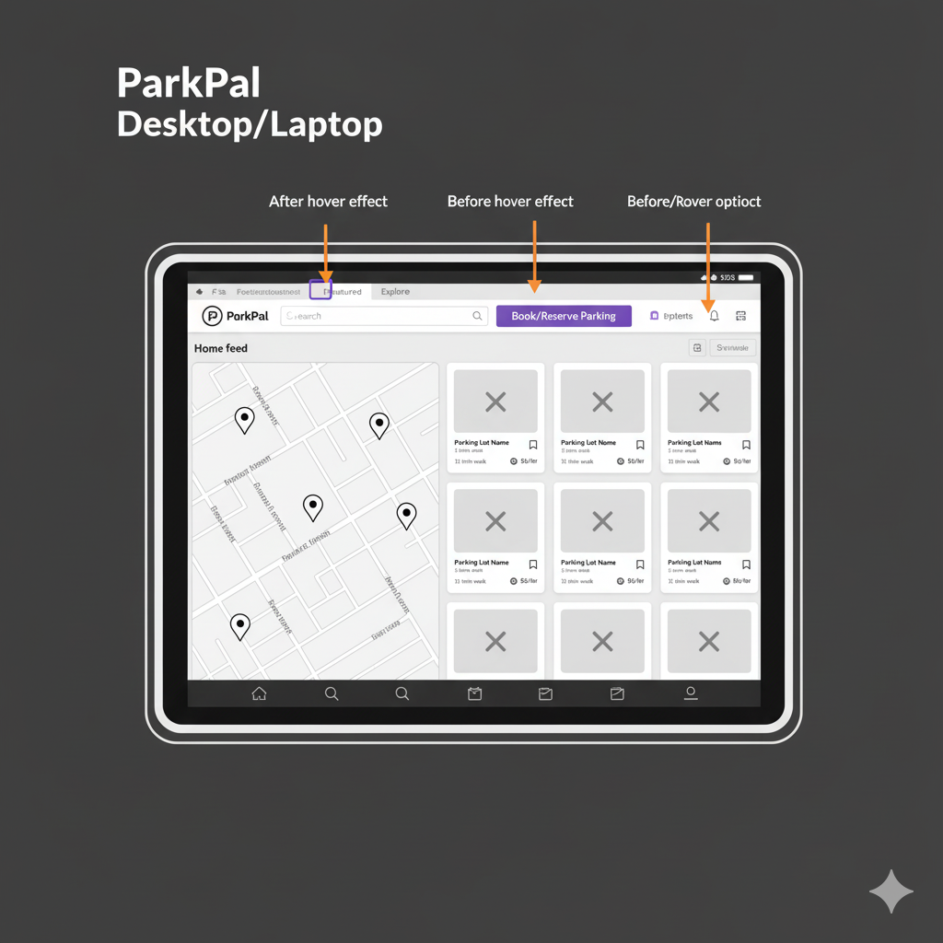

Slide 28
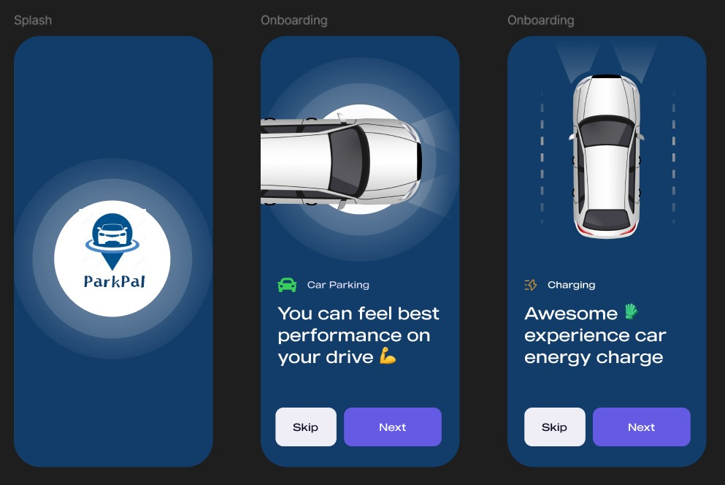
Jakob's Law
The onboarding process leverages Jakob's Law by using the standard mobile pattern of a horizontal scroll, clear dot indicators for position, and prominent "Skip" and "Next" buttons.
Users are already familiar with this interface from countless other apps, meaning they don't have to spend time learning how to navigate the introduction. This high level of familiarity reduces cognitive load and allows users to quickly proceed to the main functionality.

Slide 29
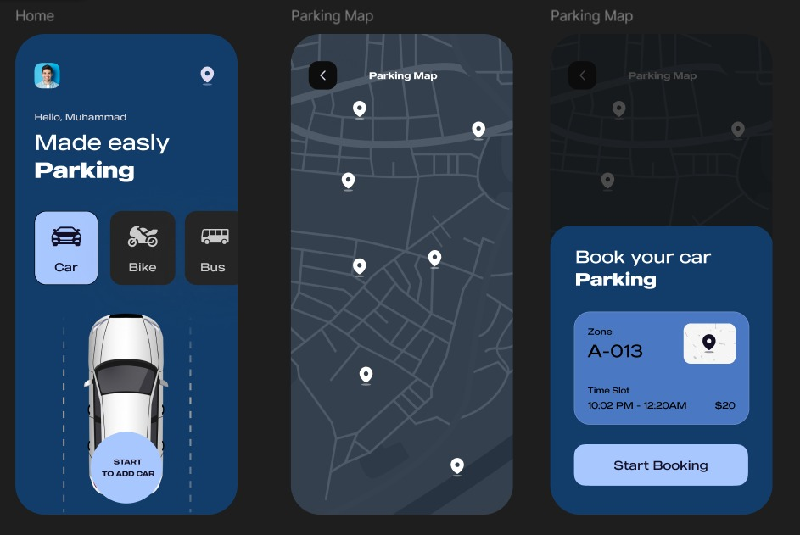
Fitt’s Law
The time to acquire a target is determined by its size and distance. The "Start Booking" button, located in the bottom action sheet, is designed as a large, full-width target. This ensures that the user, who is likely focused on the map, can quickly and accurately tap this most critical call-to-action with their thumb, minimizing errors and speeding up the essential booking process.

Slide 30
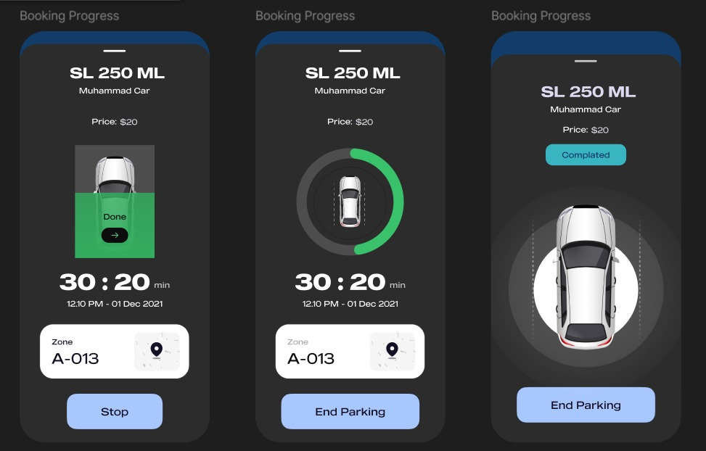
Visibility of System Status
Visibility of System Status is perfectly demonstrated on the 'Booking Progress' screens. The app provides continuous, real-time feedback through a prominently displayed, countdown timer (30:20 min) and a clear circular progress indicator around the car
Graphic.
By showing the user, the exact time remaining and the visual status (progress circle filling/unfilling), the system reassures them that their parking session is active and acknowledged, reducing anxiety and building immediate trust in the application's functionality.

Slide 31
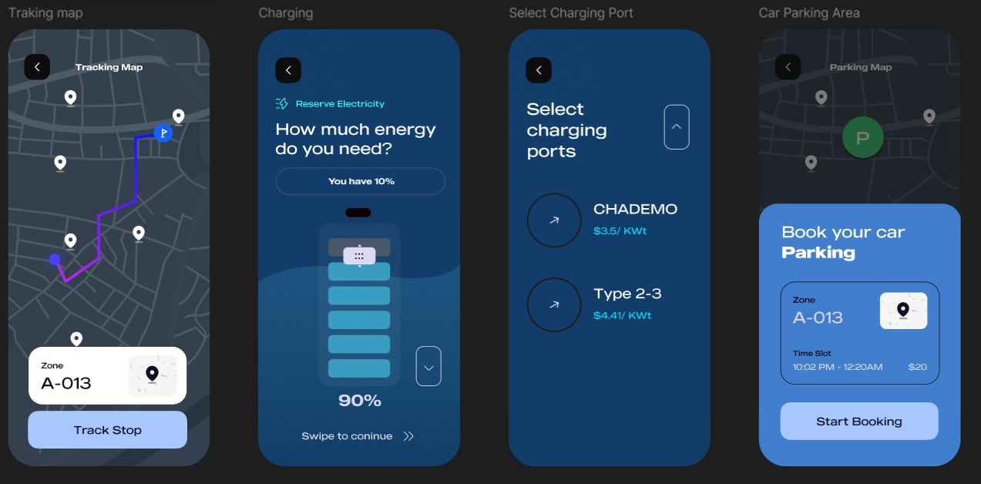
Hick’s Law
The more choices presented, the longer it takes to decide.
The 'Select Charging Port' screen only presents two distinct options: CHADEMO and Type 2-3. By limiting the available choices to the absolute necessary minimum and using large, clear labels for each, the app dramatically cuts down the user's decision time, maintaining a fast and efficient flow.

Slide 32
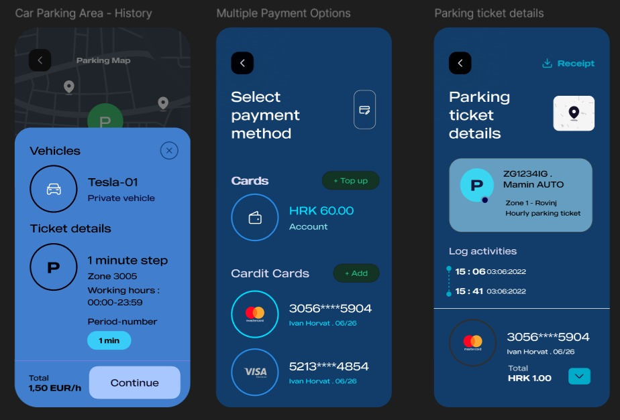
Law of Common Region
Elements within the same boundary are perceived as being grouped together. On the 'Multiple Payment Options' screen, each credit card (Mastercard and VISA) is contained within a clearly defined, rounded card shape. This boundary instantly groups the card number, type, and expiration date as a single, selectable option, making the list easy to scan and the different payment methods immediately distinct from one another.

Slide 33
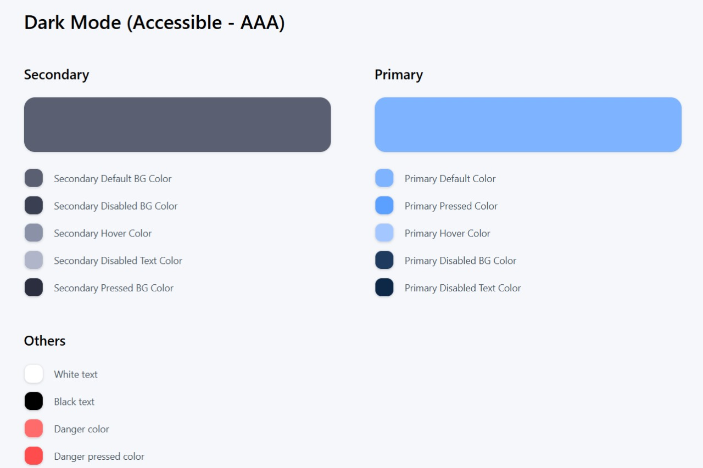
Styles Guide

Slide 34
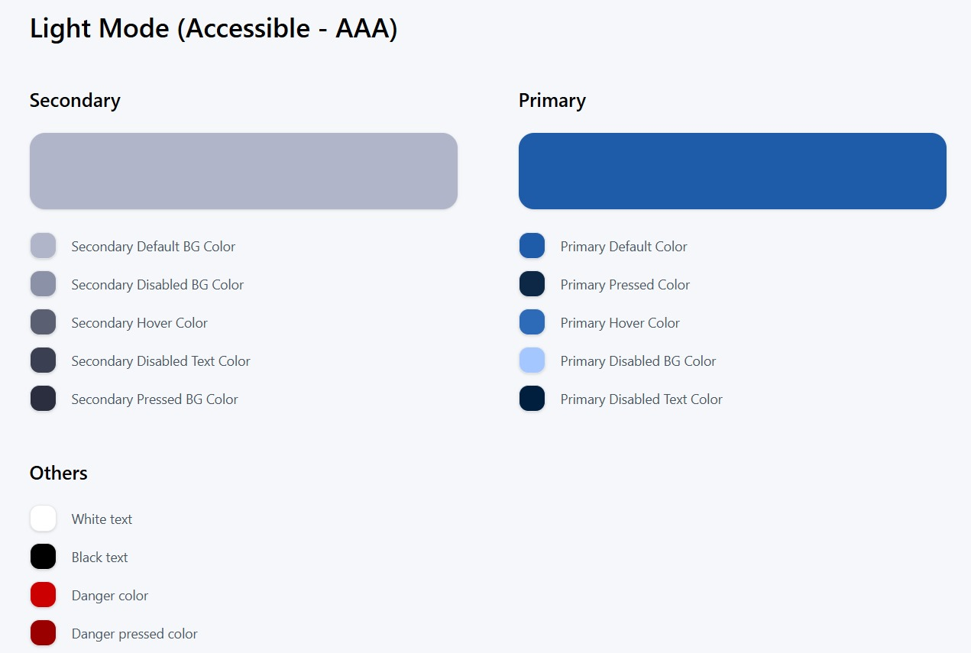
Styles Guide ​

Slide 35
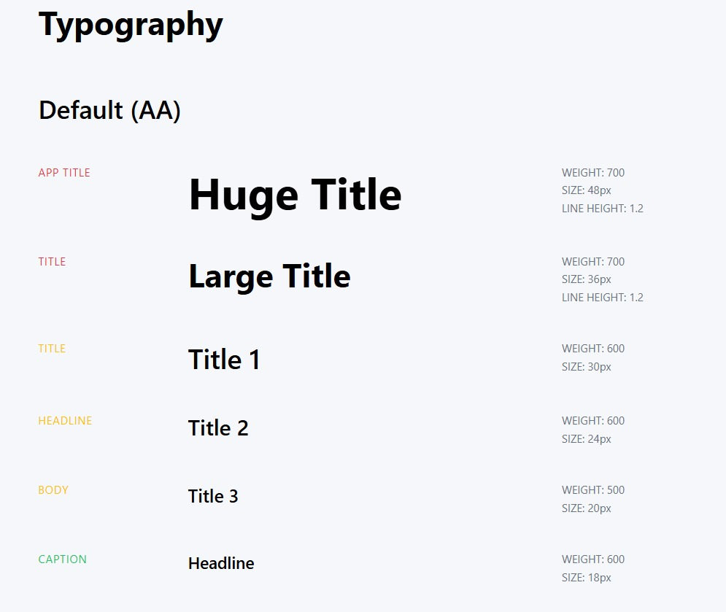
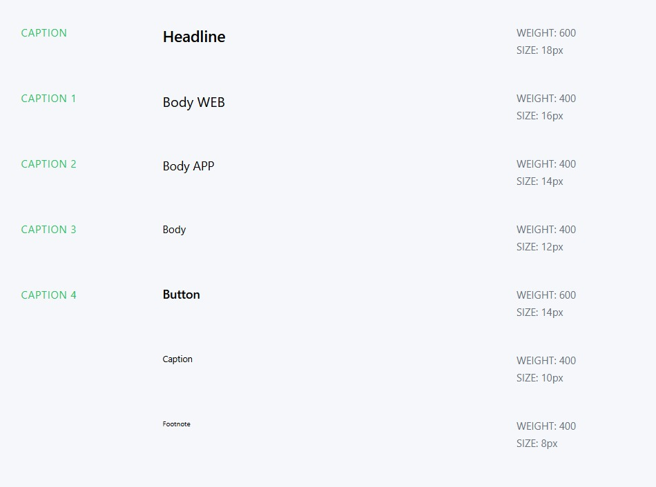
Typography

Slide 36
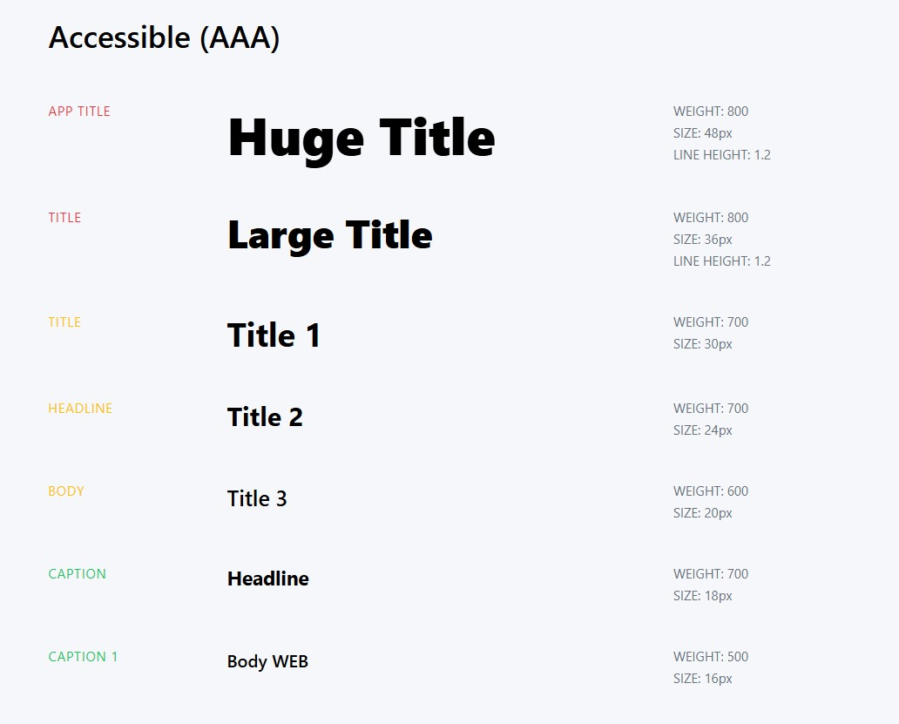
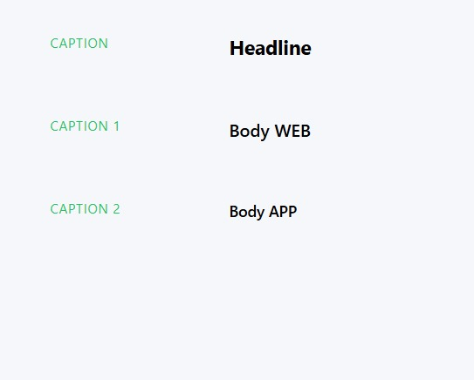
Typography

Slide 37
Thank You! ParkPal from Team UI Giants

